Slide 1
Analisis Regresi Linear
Bagus Sartono
Notes:
NOTE:
To change the image on this slide, select the picture and delete it. Then click the Pictures icon in the placeholder to insert your own image.

Slide 2
Hubungan Antar Peubah
Dari setiap objek/individu/tempat/dll dapat diukur/dicatat/diamati lebih dari satu buah peubah.
Nilai dari suatu peubah bersifat:
saling bebas dengan peubah lain
saling terkait dengan peubah lain

Slide 3
Hubungan antar Peubah
berat
badan
suhu rata-rata
tinggi badan
ketinggian tempat

Slide 4
Koefisien Korelasi
Diperlukan sebuah ukuran yang dapat mencirikan keeratan hubungan antar dua peubah.
Koefisien Korelasi (ρ ; baca: rho)
nilainya: -1 ≤ ρ ≤ 1
tanda menunjukkan arah hubungan
besar/magnitude menunjukkan kekuatan hubungan
koefisien korelasi data contoh dinotasikan r

Slide 5
Koefisien Korelasi (Pearson)
Jika ada dua peubah X dan Y, korelasi antara keduanya adalah

Slide 6
Koefisien Korelasi (+)
r = 0.70
r = 0.58
r = 0.95

Slide 7
Koefisien Korelasi (-)
r = -0.68
r = -0.58
r = -0.90

Slide 8
Ilustrasi
Tinggi Badan | Berat Badan
165 | 49
159 | 58
166 | 60
173 | 67
179 | 69
164 | 56
163 | 53
154 | 51
170 | 60
158 | 44

Slide 9
Ilustrasi
x | y | x-xbar | y-ybar | (x-xbar)² | (y-ybar)² | (x-xbar)(y-ybar)
165 | 49 | -0.1 | -7.7 | 0.01 | 59.29 | 0.77
159 | 58 | -6.1 | 1.3 | 37.21 | 1.69 | -7.93
166 | 60 | 0.9 | 3.3 | 0.81 | 10.89 | 2.97
173 | 67 | 7.9 | 10.3 | 62.41 | 106.09 | 81.37
179 | 69 | 13.9 | 12.3 | 193.21 | 151.29 | 170.97
164 | 56 | -1.1 | -0.7 | 1.21 | 0.49 | 0.77
163 | 53 | -2.1 | -3.7 | 4.41 | 13.69 | 7.77
154 | 51 | -11.1 | -5.7 | 123.21 | 32.49 | 63.27
170 | 60 | 4.9 | 3.3 | 24.01 | 10.89 | 16.17
158 | 44 | -7.1 | -12.7 | 50.41 | 161.29 | 90.17
165.1 | 56.7 |  | jumlah | 496.9 | 548.1 | 426.3

Slide 10
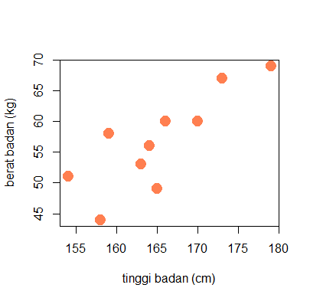
R SESSION
#membaca data
data <- read.csv("D:/cor 01.csv")
head(data)
#scatter plot
plot(data$tinggi, data$berat, cex=2, pch=19,
col="coral", xlab="tinggi badan (cm)",
ylab="berat badan (kg)")

Slide 11
R SESSION
#menghitung korelasi
cor(data$tinggi, data$berat)
#menguji signififansi korelasi
cor.test(data$tinggi, data$berat)
> cor(data$tinggi, data$berat)
[1] 0.8168662
> #menguji signififansi korelasi
> cor.test(data$tinggi, data$berat)
Pearson's product-moment correlation
data: data$tinggi and data$berat
t = 4.0054, df = 8, p-value = 0.00392
alternative hypothesis: true correlation is not equal to 0
95 percent confidence interval:
0.3855215 0.9552090
sample estimates:
cor
0.8168662

Slide 12
Regresi Linear: Pengantar
Terdapat 2 peubah numerik : peubah yang satu mempengaruhi peubah yang lain
Peubah yang mempengaruhi → X, peubah bebas (independent), peubah penjelas (explanatory)
Peubah yang dipengaruhi → Y, peubah tak bebas (dependent), peubah respon (response)

Slide 13
Pengantar
Misalnya ingin melihat hubungan antara pengeluaran untuk iklan (adv expenditures, X) dengan penerimaan melalui penjualan (sales revenue, Y)
Bulan | 1 | 2 | 3 | 4 | 5 | 6 | 7 | 8 | 9 | 10
X | 10 | 9 | 11 | 12 | 11 | 12 | 13 | 13 | 14 | 15
Y | 44 | 40 | 42 | 46 | 48 | 52 | 54 | 58 | 56 | 60

Slide 14
Pengantar

Slide 15
Pengantar
Ingin dibuat model
Y = β₀ + β₁X + e
Model memuat error, selisih nilai sebenarnya dengan dugaan berdasar model

Slide 16
Bagaimana mendapatkan a dan b?
Metode yang digunakan : OLS (ordinary least squares/kuadrat terkecil), mencari a dan b sehingga jumlah kuadrat error paling kecil
Cari penduga a dan b sehingga
minimum

Slide 17
Bagaimana mendapatkan a dan b?
Rata-rata Y
Rata-rata X

Slide 18
Ilustrasi Perhitungan
X | Y | (X - Xbar) | (Y - Ybar) | (X - Xbar)(Y - Ybar) | (X - Xbar)²
10 | 44 | -2 | -6 | 12 | 4
9 | 40 | -3 | -10 | 30 | 9
11 | 42 | -1 | -8 | 8 | 1
12 | 46 | 0 | -4 | 0 | 0
11 | 48 | -1 | -2 | 2 | 1
12 | 52 | 0 | 2 | 0 | 0
13 | 54 | 1 | 4 | 4 | 1
13 | 58 | 1 | 8 | 8 | 1
14 | 56 | 2 | 6 | 12 | 4
15 | 60 | 3 | 10 | 30 | 9
b₁ = 106 / 30 = 3.533
b₀ = 50 – 3.533 (12) = 7.60

Slide 20
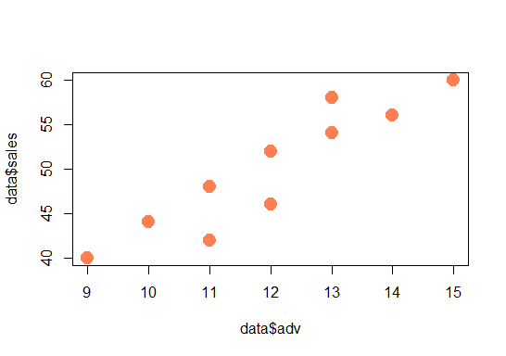
#membaca data
data <- read.csv("D:/reg 01.csv")
head(data)
#scatter plot
plot(data$adv, data$sales, cex=2, pch=19, col="coral")

Slide 21
R SESSION
#membaca data
data <- read.csv("D:/reg 01.csv")
head(data)
#menghasilkan model regresi
model.adv <- lm(sales ~ adv, data=data)
#menampilkan model regresi
model.adv
#menampilkan hasil pengujian
summary(model.adv)

Slide 22
> model.adv
Call:
lm(formula = sales ~ adv, data = data)
Coefficients:
(Intercept) adv
7.600 3.533

Slide 23
Interpretasi a dan b Y = 7.6 + 3.53 X Penerimaan = 7.6 + 3.53 Belanja Iklan
a = intersep/intercept = besarnya nilai Y ketika X sebesar 0
b = gradient/slope = besarnya perubahan nilai Y ketika X berubah satu satuan. Tanda koefisien b menunjukkan arah hubungan X dan Y
Pada kasus ilustrasi
a = 7.6 → besarnya sales revenue jika tidak ada belanja iklan adalah 7.6 juta dolar
b = 3.533 → jika belanja iklan dinaikkan 1 juta dolar maka sales revenue naik 3.533 juta dolar

Slide 24
Uji Signifikasi Koefisien b
H₀ : b = 0 (artinya X tidak mempengaruhi Y)
H₁ : b ≠ 0 (artinya X mempengaruhi Y)
Tolak H₀ jika nilai |t| melebihi nilai t pada tabel dengan derajat bebas (n-2) dengan tingkat kesalahan α/2

Slide 25
Uji signifikansi koefisien b
Nilai s_{b} = √ (65.47 / (8)(30)) = 0.52
Nilai t = 3.53 / 0.52 = 6.79
Nilai t pada tabel (db = 8, α = 5%) = 2.306
Kesimpulan : Tolak H₀, data mendukung kesimpulan adanya pengaruh ads expenditure terhadap sales revenue.

Slide 26
Ukuran Kebaikan Model
Menggunakan koefisien determinasi (R², R-squared)
R-squared bernilai antara 0 s/d 1
R-squared adalah persentase keragaman data yang mampu diterangkan oleh model
R-squared tinggi adalah indikasi model yang baik

Slide 27
Ukuran Kebaikan Model
Model dalam ilustrasi bisa ditunjukkan memiliki R-squared 0.85 atau 85%

Slide 28
> #menampilkan hasil pengujian
> summary(model.adv)
Call:
lm(formula = sales ~ adv, data = data)
Residuals:
Min 1Q Median 3Q Max
-4.4667 -0.9500 0.5333 1.4167 4.4667
Coefficients:
Estimate Std. Error t value Pr(>|t|)
(Intercept) 7.6000 6.3323 1.200 0.264397
adv 3.5333 0.5223 6.765 0.000143 ***
Signif. codes:
0 ‘***’ 0.001 ‘**’ 0.01 ‘*’ 0.05 ‘.’ 0.1 ‘ ’ 1
Residual standard error: 2.861 on 8 degrees of freedom
Multiple R-squared: 0.8512, Adjusted R-squared: 0.8326
F-statistic: 45.77 on 1 and 8 DF, p-value: 0.0001428

Slide 29
Regresi Linear Berganda (multiple linear regression)

Slide 30
Pengantar
Simple Linear Regression (regresi linear sederhana): hanya ada 1 peubah penjelas. Modelnya:
Y = β₀ + β₁ X + ε
Multiple Linear Regression (regresi linear berganda): melibatkan lebih dari satu peubah penjelas. Modelnya:
Y = β₀ + β₁ X₁ + β₂ X₂ + … + β_{k} X_{k} + ε

Slide 31
Pengantar
Harga jual rumah dipengaruhi oleh beberapa peubah penjelas, misalnya: (1) luas bangunan, (2) umur bangunan, (3) jarak lokasi rumah ke jalan raya.
Tinggi pohon tanaman tertentu dipengaruhi oleh (1) umur tanaman, (2) dosis pupuk yang diberikan, (3) kandungan hara tanah, (4) curah hujan di lokasi penanaman.

Slide 32
Notasi Matriks Model Regresi
Y = β₀ + β₁ X₁ + β₂ X₂ + … + β_{k} X_{k} + ε

Slide 33
Penduga Kuadrat Terkecil (least square estimator)
Penduga OLS (ordinary least squares) bagi β adalah
bersifat BLUE (best linear unbiased estimator) jika
E(ε) = 0
var(ε) = σ²
cov(ε_{i}, ε_{j}) = 0
ε menyebar normal

Slide 34
Pengujian Pengaruh Variabel Penjelas
Uji Simultan
ANOVA digunakan untuk menguji secara simultan pengaruh seluruh X terhadap Y
H₀: semua b_{i} = 0 (tidak ada X yang berpengaruh terhadap Y)
H₁: ada b_{i} ≠ 0 (ada X yang berpengaruh terhadap Y)
Jika nilai p-value kecil, disimpulkan tolak H₀. dengan kata lain, jika nilai p-value kecil berarti ada X yang berpengaruh terhadap Y.
Sebaliknya, jika p-value besar, maka tidak ada X yang pengaruhnya signifikan.

Slide 35
Pengujian Pengaruh Variabel Penjelas
Uji Parsial → uji t
Menguji pengaruh setiap variabel penjelas satu persatu.
Dilakukan jika uji simultan menyatakan tolak H₀ (signifikan)

Slide 36
Kebaikan model regresi
Dilihat dari nilai koefisien determinasi (R²) → merupakan ukuran seberapa besar keragaman dari peubah respon (y) dapat dijelaskan oleh model (peubah penjelas (x))
Nilainya antara 0-100%, semakin mendekati 100% maka semakin bagus

Slide 37
Ilustrasi
Model
Variabel Respon: Harga (harga jual rumah dalam satuan juta rupiah)
Variabel Penjelas:
Luasbangunan (luas bangunan rumah dalam satuan meter persegi)
Umur (umur bangunan dalam satuan tahun)
Kamarmandi (banyaknya kamar mandi di dalam rumah)

Slide 38
Kemungkinan Pelanggaran Asumsi
Tidak Linear, yang salah satunya berujung pada error masih memiliki pola (tidak acak)
Error masih memiliki pola secara waktu maupun space
Heteroskedastic (variance error tidak konstan, tidak homogen)
Error tidak menyebar normal

Slide 39
Pemeriksaan Pelanggaran Asumsi
Diagnostic Plots
Plot antara Standardized Residuals vs Predicted Values
Plot Peluang Normal (normal probability plot) dari Residual
Histogram Residual
Untuk data time series, auto-correlogram atau ACF plot

Slide 40
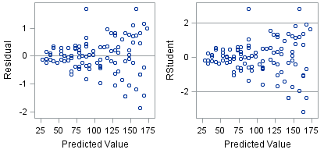
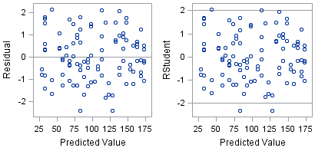
Diagnostic Plots: Plot antara Standardized Residuals vs Predicted Values
Heteroskedastic
Homoskedastic

Slide 41
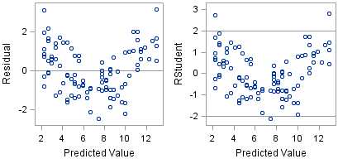
Diagnostic Plots: Plot antara Standardized Residuals vs Predicted Values
Masih terlihat pola, tidak linear?
Tampak acak residualnya

Slide 42
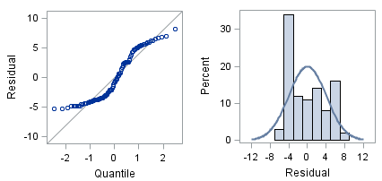
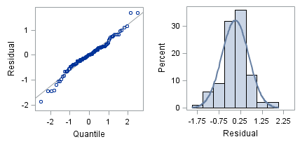
Diagnostic Plots: Plot Peluang Normal dan Histogram
Tidak normal
Normal

Slide 43
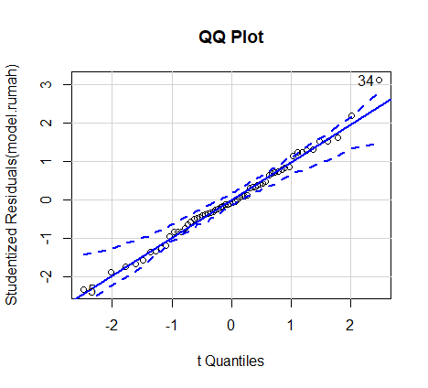
Memeriksa Kenormalan Residual
# Normality of Residuals
# qq plot for studentized resid
library(car)
qqPlot(model.rumah, main="QQ Plot")

Slide 44
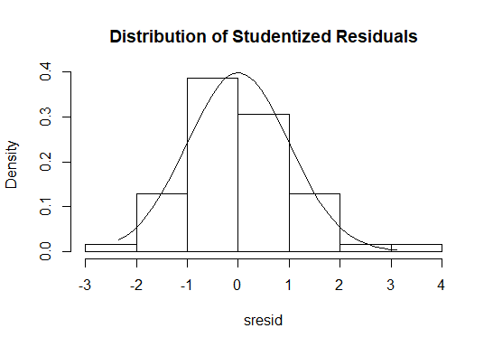
Memeriksa Kenormalan Residual
# Normality of Residuals
# distribution of studentized residuals
library(MASS)
sresid <- studres(model.rumah)
hist(sresid, freq=FALSE, main="Distribution of Studentized Residuals")
xfit<-seq(min(sresid),max(sresid),length=40)
yfit<-dnorm(xfit)
lines(xfit, yfit)

Slide 45
Memeriksa Kenormalan Residual
> #kolmogorov-smirnov test
> ks.test(sresid, pnorm)
One-sample Kolmogorov-Smirnov test
data: sresid
D = 0.0703, p-value = 0.8979
alternative hypothesis: two-sided

Slide 46
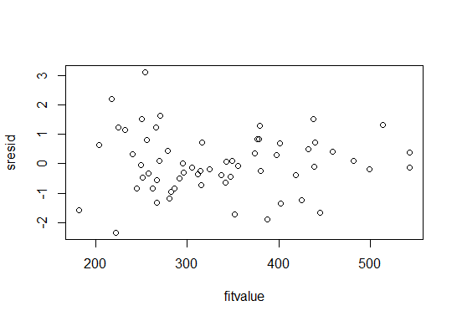
# Evaluate homoscedasticity
# plot studentized residuals vs. fitted values
sresid <- studres(model.rumah)
fitvalue <- fitted.values(model.rumah)
plot(fitvalue, sresid)

Slide 47
Terima kasih

Slide 48
THIS IS YOUR PRESENTATION TITLE

Slide 49
INSTRUCTIONS FOR USE
EDIT IN GOOGLE SLIDES
Click on the button under the presentation preview that says "Use as Google Slides Theme".
You will get a copy of this document on your Google Drive and will be able to edit, add or delete slides.
You have to be signed in to your Google account.
EDIT IN POWERPOINT®
Click on the button under the presentation preview that says "Download as PowerPoint template". You will get a .pptx file that you can edit in PowerPoint.
Remember to download and install the fonts used in this presentation (you’ll find the links to the font files needed in the Presentation design slide)
More info on how to use this template at www.slidescarnival.com/help-use-presentation-template
This template is free to use under Creative Commons Attribution license. You can keep the Credits slide or mention SlidesCarnival and other resources used in a slide footer.

Slide 50
HELLO!
I am Jayden Smith
I am here because I love to give presentations.
You can find me at @username

Slide 51
TRANSITION HEADLINE
1
Let’s start with the first set of slides

Slide 52
Quotations are commonly printed as a means of inspiration and to invoke philosophical thoughts from the reader.

Slide 53
THIS IS A SLIDE TITLE
Here you have a list of items
And some text
But remember not to overload your slides with content
Your audience will listen to you or read the content, but won’t do both.

Slide 54
BIG CONCEPT
Bring the attention of your audience over a key concept using icons or illustrations

Slide 55
YOU CAN ALSO SPLIT YOUR CONTENT
WHITE
Is the color of milk and fresh snow, the color produced by the combination of all the colors of the visible spectrum.
BLACK
Is the color of coal, ebony, and of outer space. It is the darkest color, the result of the absence of or complete absorption of light.

Slide 56
IN TWO OR THREE COLUMNS
YELLOW
Is the color of gold, butter and ripe lemons. In the spectrum of visible light, yellow is found between green and orange.
BLUE
Is the colour of the clear sky and the deep sea. It is located between violet and green on the optical spectrum.
RED
Is the color of blood, and because of this it has historically been associated with sacrifice, danger and courage.

Slide 57
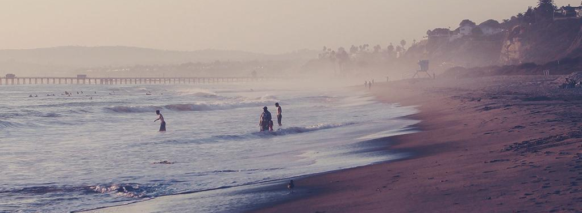
A PICTURE IS WORTH A THOUSAND WORDS
A complex idea can be conveyed with just a single still image, namely making it possible to absorb large amounts of data quickly.

Slide 58

WANT BIG IMPACT?
Use big image

Slide 59
USE CHARTS TO EXPLAIN
YOUR IDEAS
White
Gray
Black

Slide 60
AND TABLES TO
COMPARE DATA
 | A | B | C
Yellow | 10 | 20 | 7
Blue | 30 | 15 | 10
Orange | 5 | 24 | 16

Slide 61

MAPS
OUR OFFICE

Slide 62
89,526,124
Whoa! That’s a big number, aren’t you proud?

Slide 63
89,526,124$
185,244 users
100%
That’s a lot of money
And a lot of users
Total success!

Slide 64
OUR PROCESS IS EASY
first
second
last

Slide 65
LET’S REVIEW
SOME CONCEPTS
YELLOW
Is the color of gold, butter and ripe lemons. In the spectrum of visible light, yellow is found between green and orange.
BLUE
Is the colour of the clear sky and the deep sea. It is located between violet and green on the optical spectrum.
RED
Is the color of blood, and because of this it has historically been associated with sacrifice, danger and courage.
YELLOW
Is the color of gold, butter and ripe lemons. In the spectrum of visible light, yellow is found between green and orange.
BLUE
Is the colour of the clear sky and the deep sea. It is located between violet and green on the optical spectrum.
RED
Is the color of blood, and because of this it has historically been associated with sacrifice, danger and courage.

Slide 66
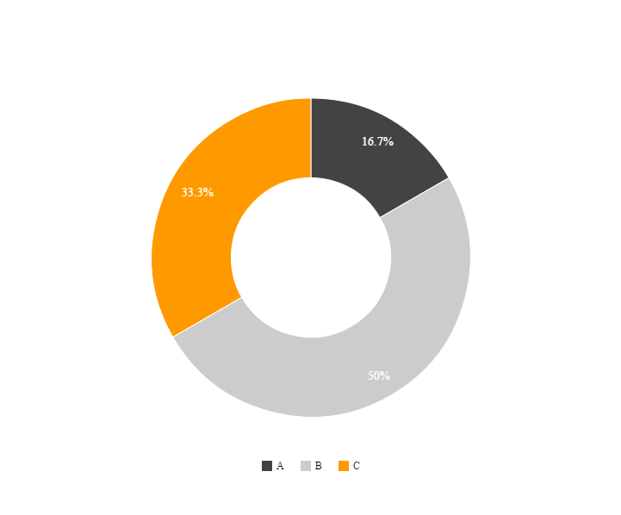
You can copy&paste graphs from Google Sheets

Slide 67
ANDROID PROJECT
Show your web, app or software projects...
...using these gadget templates.
Place your screenshot here

Slide 68
iPHONE PROJECT
Show your web, app or software projects...
...using these gadget templates.
Place your screenshot here

Slide 69
TABLET PROJECT
Show your web, app or software projects...
...using these gadget templates.
Place your screenshot here

Slide 70
DESKTOP
PROJECT
Show your web, app or software projects...
Place your screenshot here
...using these gadget templates.

Slide 71
THANKS!
Any questions?
You can find me at
@username
user@mail.me

Slide 72
CREDITS
Special thanks to all the people who made and released these awesome resources for free:
Presentation template by SlidesCarnival
Photographs by Unsplash

Slide 73
PRESENTATION DESIGN
This presentations uses the following typographies and colors:
Titles: Montserrat
Body copy: Droid serif
You can download the fonts on these pages:
https://www.fontsquirrel.com/fonts/montserrat
https://www.fontsquirrel.com/fonts/droid-serif
Orange #ff9e00
Dark gray #434343
You don’t need to keep this slide in your presentation. It’s only here to serve you as a design guide if you need to create new slides or download the fonts to edit the presentation in PowerPoint®

Slide 74
SlidesCarnival icons are editable shapes.
This means that you can:
Resize them without losing quality.
Change fill color and opacity.
Change line color, width and style.
Isn’t that nice? :)
Examples:

Slide 75
😉
Now you can use any emoji as an icon!
And of course it resizes without losing quality and you can change the color.
How? Follow Google instructions https://twitter.com/googledocs/status/730087240156643328
✋👆👉👍👤👦👧👨👩👪💃🏃💑❤😂😉😋😒😭👶😸🐟🍒🍔💣📌📖🔨🎃🎈🎨🏈🏰🌏🔌🔑 and many more...

